Slide 1

Module 6
Recurrent Neural Networks
Notes:
Guidelines
Use section headers to chunk content in your presentation.
Use the same style of section header throughout your presentation.
Keep your title to no more than 2 lines.

Slide 2
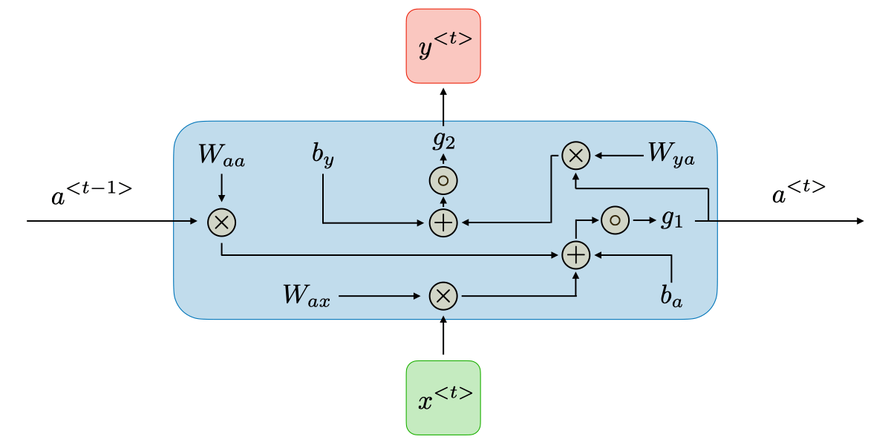
DL: RNNs
Notes:
Guidelines
Use a title slide at the beginning of your presentation. There are 9 variations of title slides to choose from.
If you will have a series of slideshows, we recommend using the same style of title slide for each presentation.
Keep your title to no more than 2 lines.
Do not change the font style or font size of the title or subtitle.

Slide 3
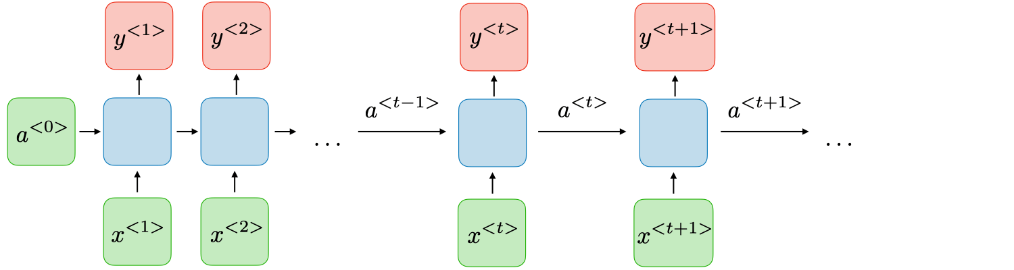
Recurrent Neural Networks
Composed on cells with recurrent loops

Slide 4
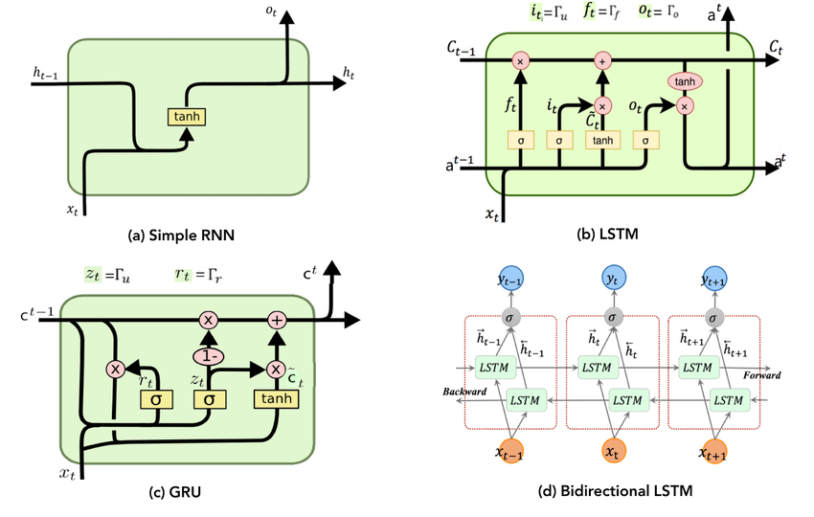
Recurrent Neural Networks
Simple RNN cells pass a hidden state over the loop
The hidden state keeps information about previous values
HIDDEN STATE

Slide 5
Back Propagation over Time
Error is propagated backward over time to update the weights
Vanishing gradient or exploding gradients are issues
Early values of the sequence have less importance
Short-term memory is lost fast

Slide 6

Back Propagation over Time

Slide 7
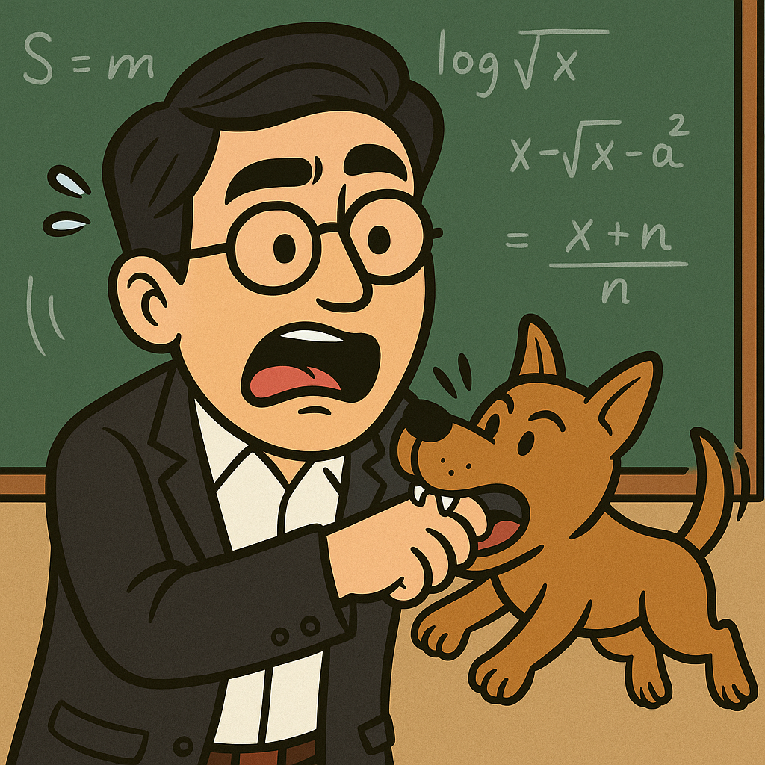
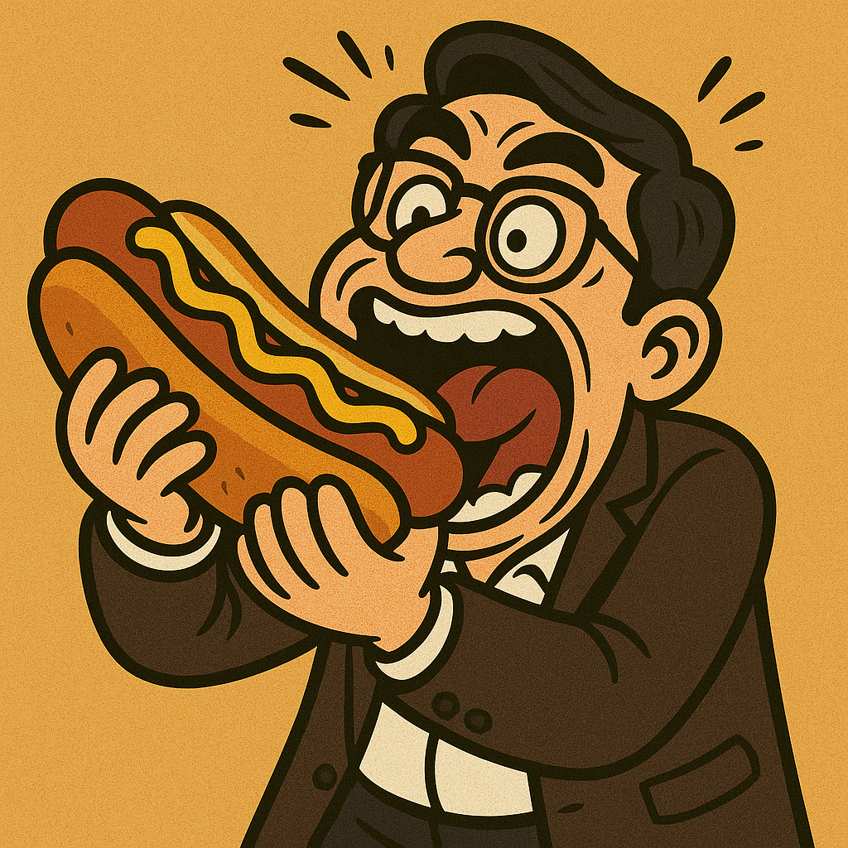
Text as sequences
Sequences are important in text learning
Words in a sentence depend on the words before and after them.
Meaning often changes based on order and context
A dog bit Dr. Martinez
Dr. Martinez bit the hot dog

Slide 8
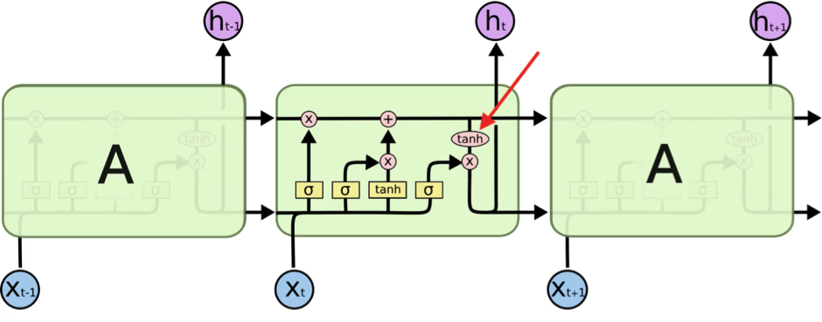
Long Short-Term Memory (LSTM)
It is a type of RNN (works with sequences)
Deals with the vanishing gradient problem
Allows information to persist (long-term)

Slide 9
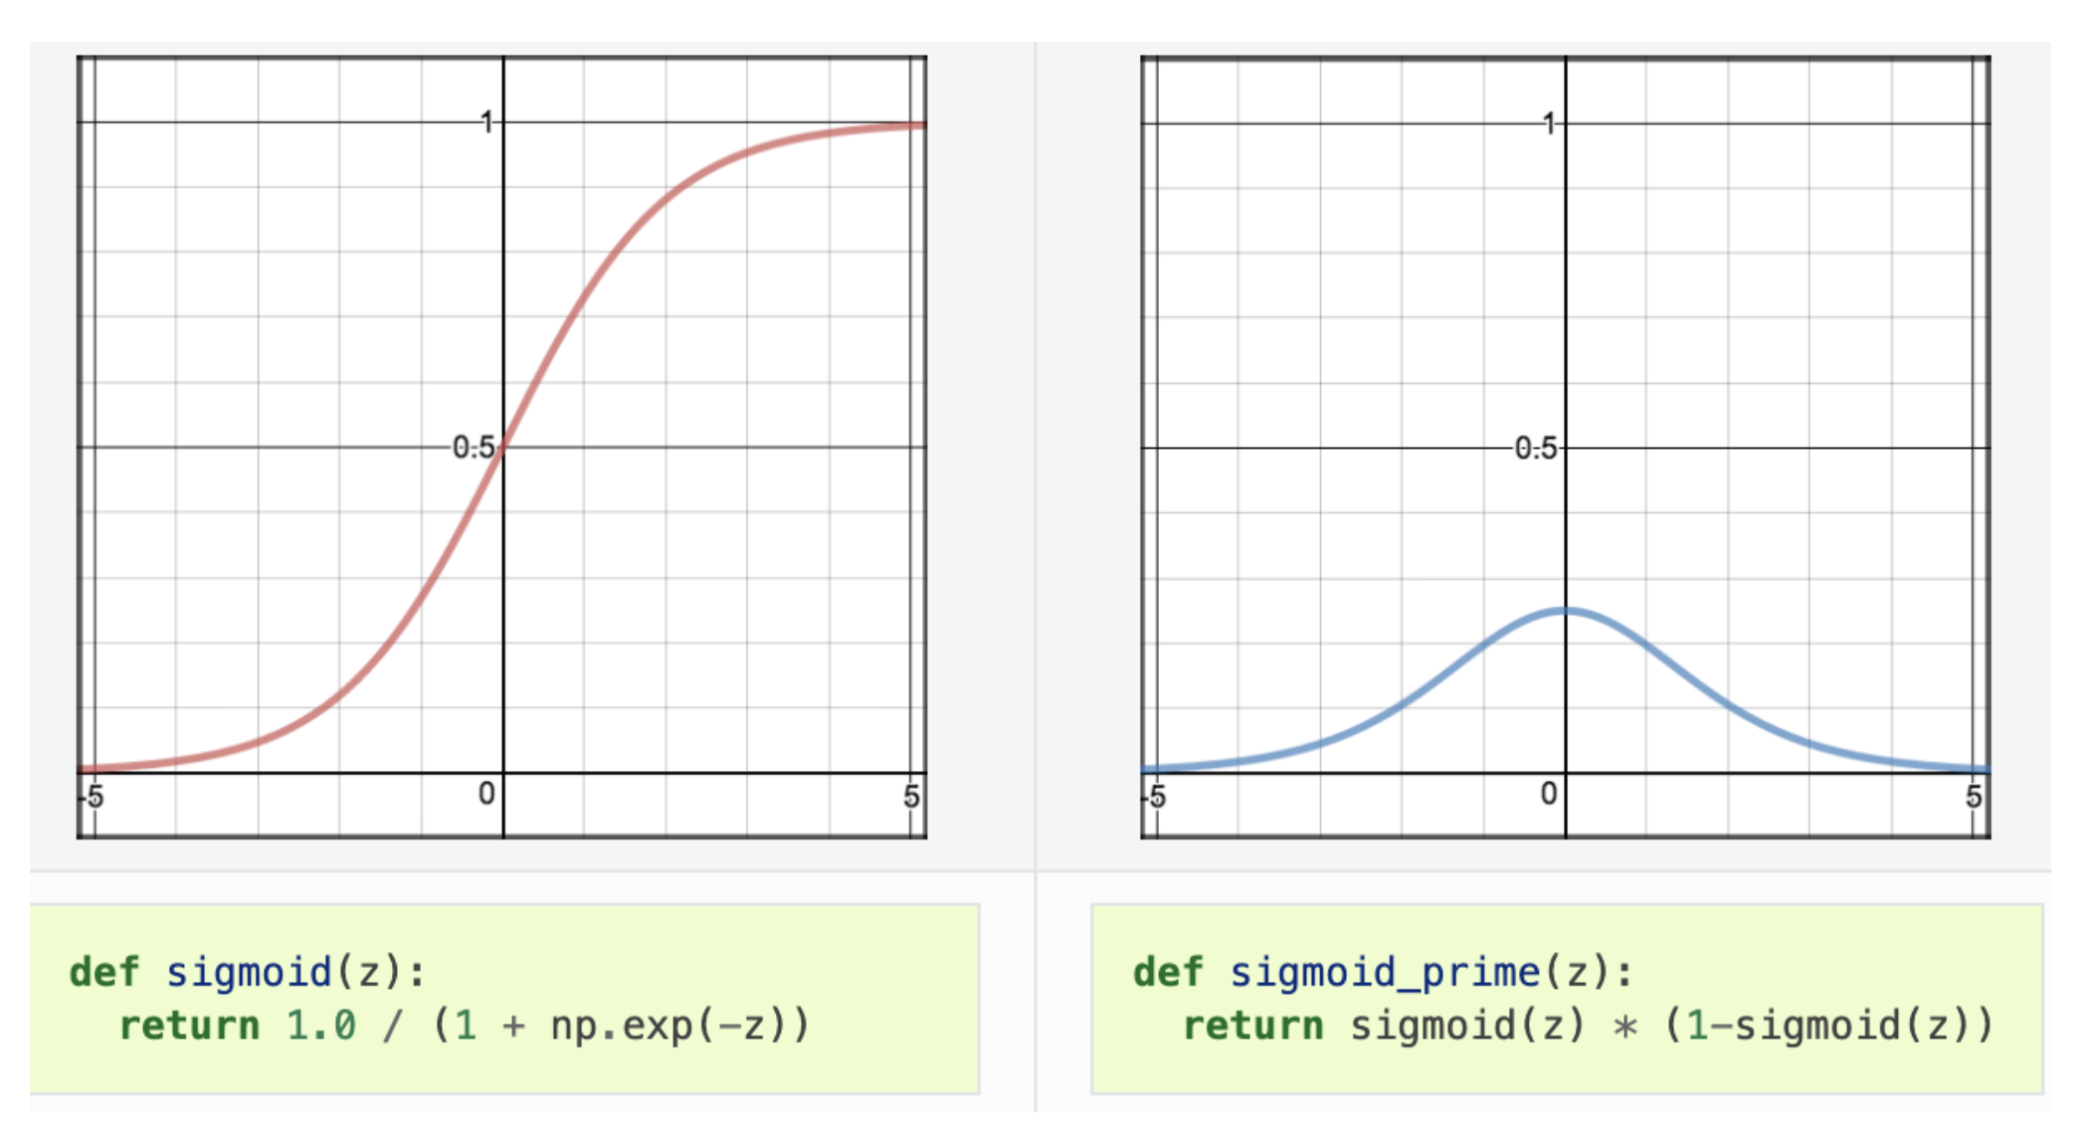
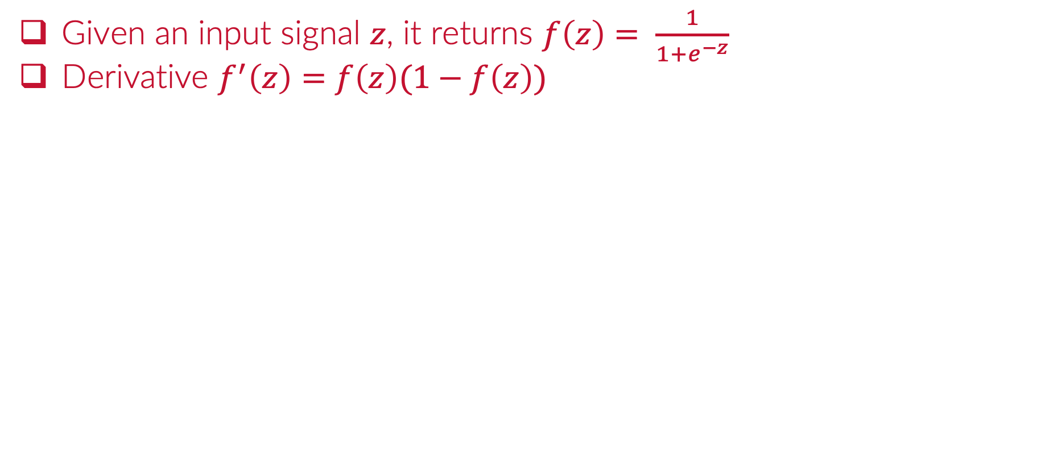
Review Activations: Sigmoid / Logistic
Given an input signal $z$, it returns $f\left(z\right)= \frac{1}{1+e^{−z}}$
Derivative $f^{′}\left(z\right)=f\left(z\right)(1−f\left(z\right))$

Slide 10
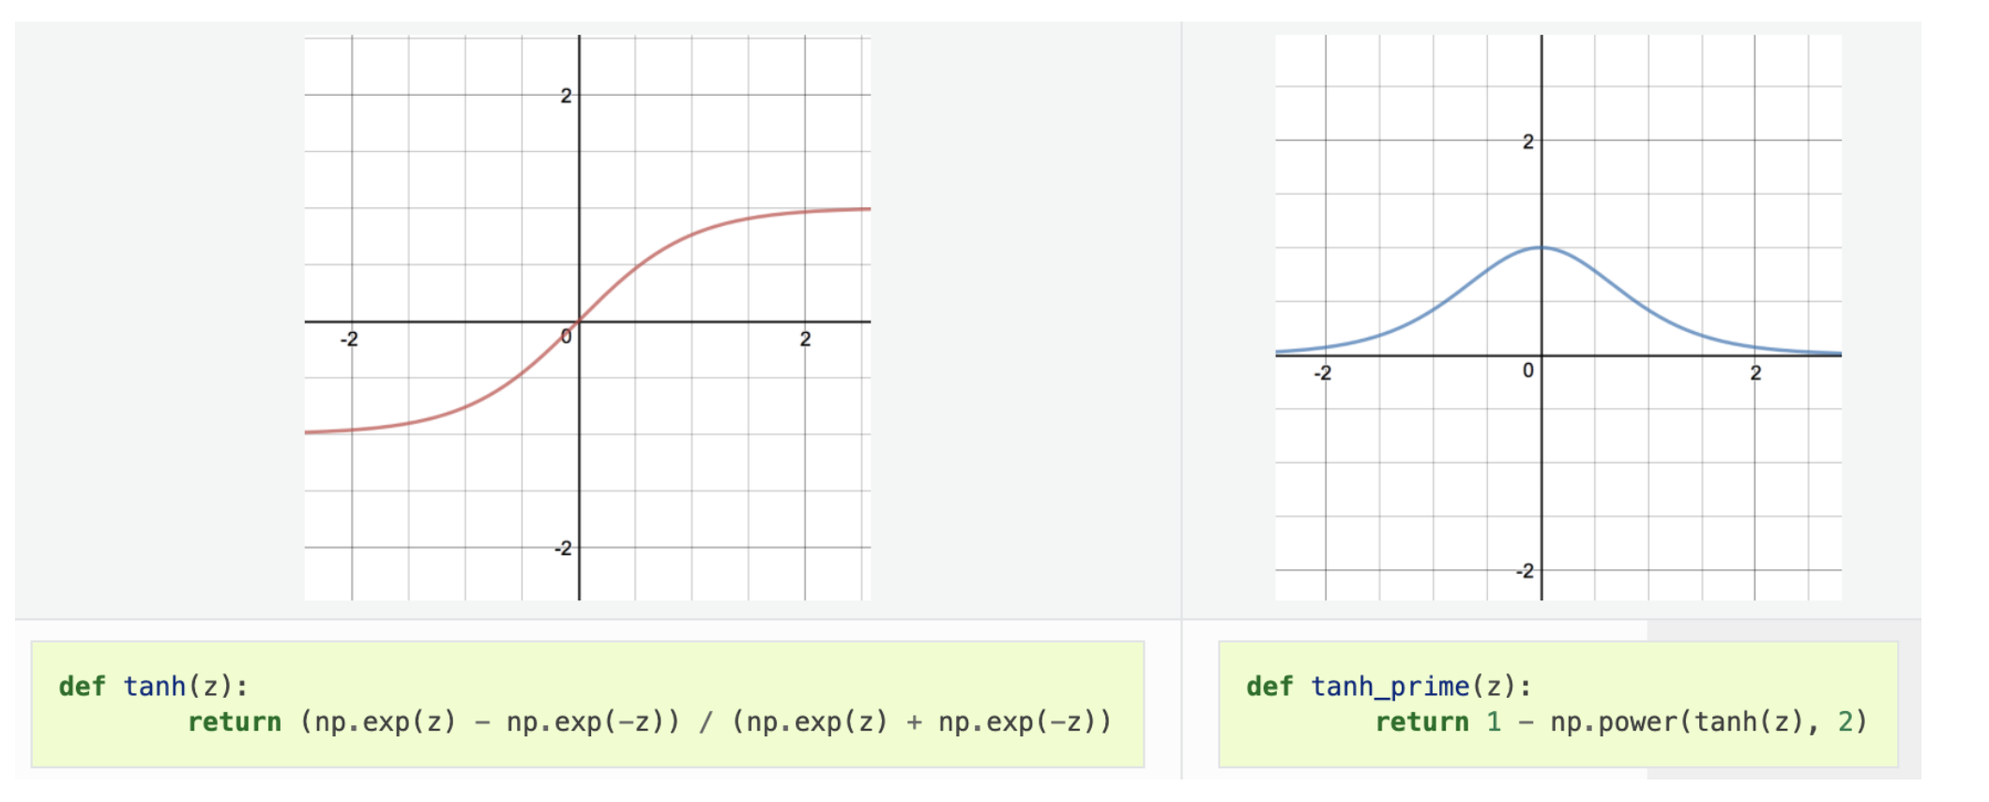
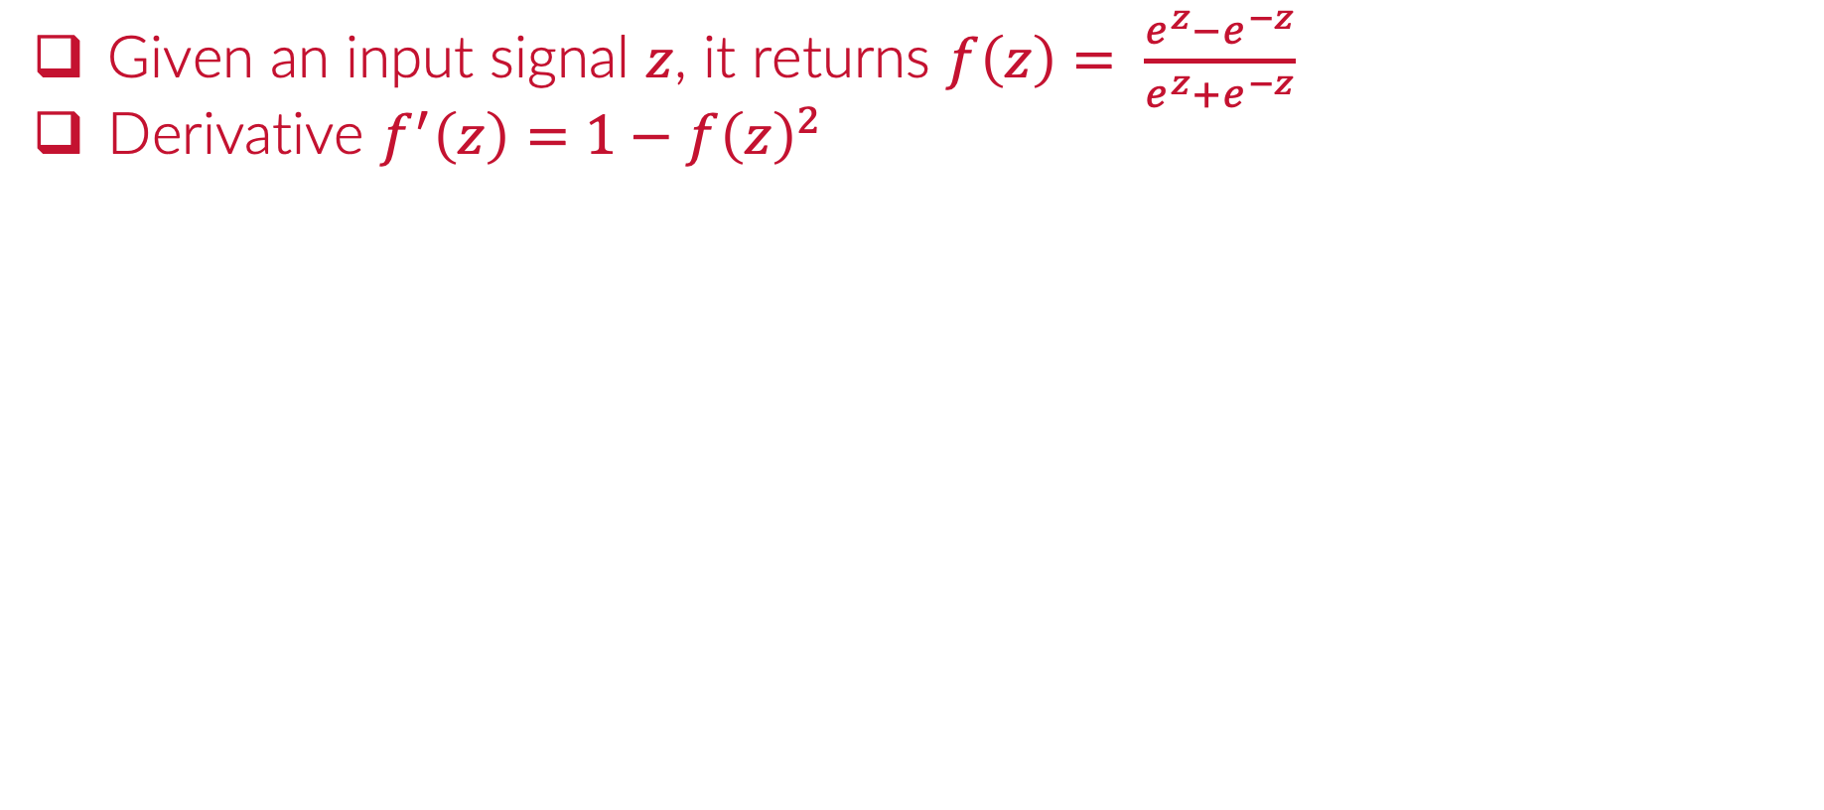
Review Activations: ”tanh”
Given an input signal $z$, it returns $f\left(z\right)= \frac{e^{z}−e^{−z}}{e^{z}+e^{−z}}$
Derivative $f^{′}\left(z\right)=1−f{\left(z\right)}^{2}$

Slide 11
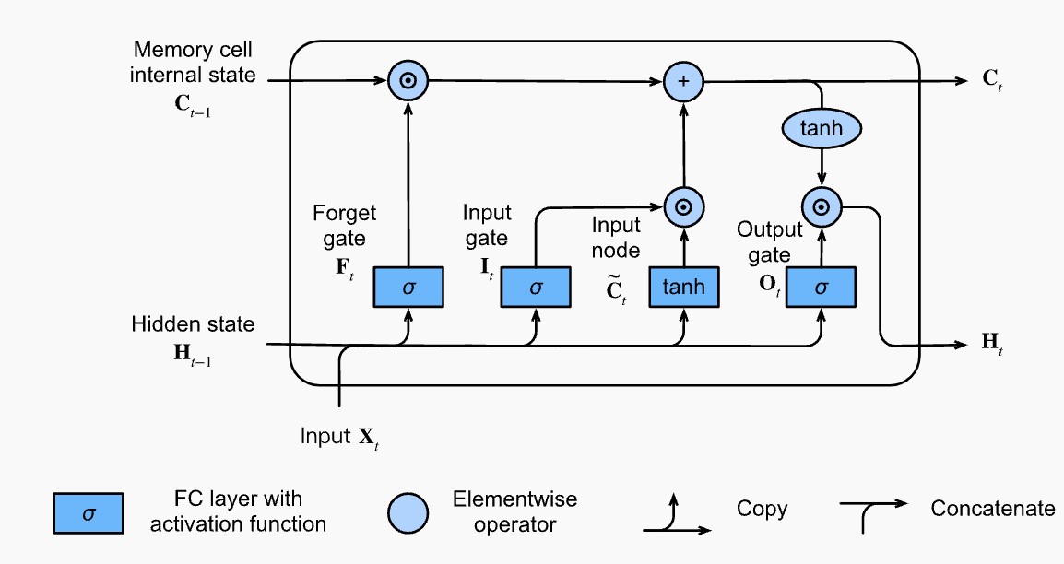
Long Short-Term Memory (LSTM)
Neurons are composed on multiple operations
SHORT-TERM MEMORY (HIDDEN STATE)

Slide 12
Long Short-Term Memory (LSTM)
Neurons are composed on multiple operations
LONG-TERM MEMORY (INTERNAL STATE)

Slide 13
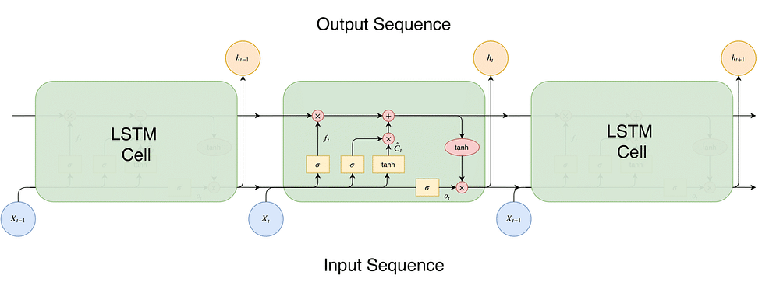
Long Short-Term Memory (LSTM)
Neurons are composed on multiple operations

Slide 14
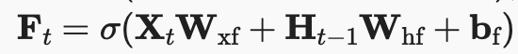
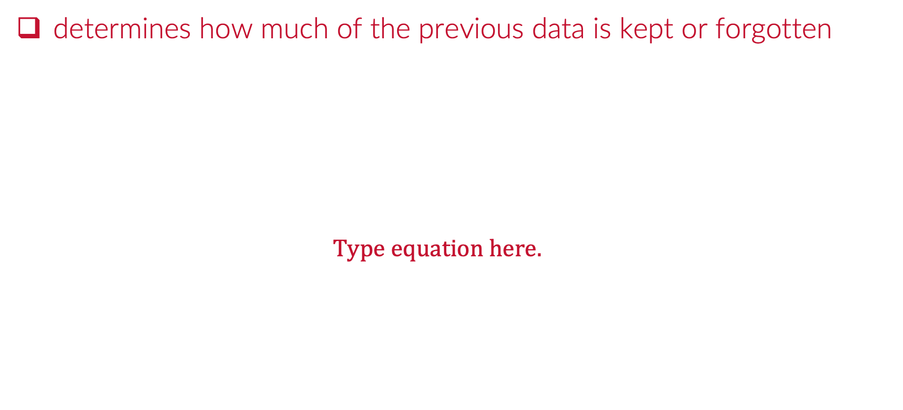
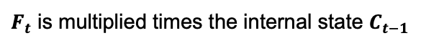
LSTM Forget Gate
determines how much of the previous data is kept or forgotten
The output will be a value between 0 and 1
$F_{t}$ is multiplied times the internal state $C_{t−1}$

Slide 15
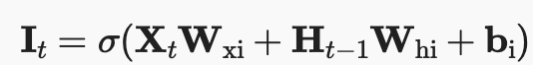
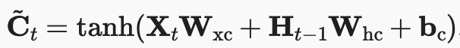
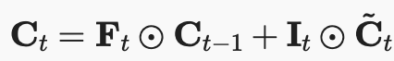
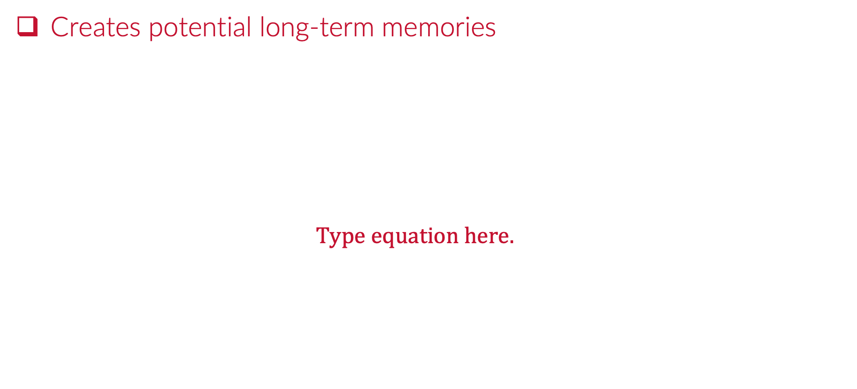
LSTM Input Gate and Input Node
Creates potential long-term memories
The output will be a value between 0 and 1
Will represent %memorized from input node
Represents the part of short-term to keep
This is how internal state is modified at this point
Forget + Remembered

Slide 16
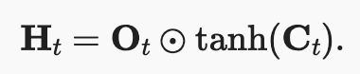
LSTM Output Gate
Creates potential long-term memories
Will represent % output maintained
Hidden state is updated with both internal state and output gate

Slide 17
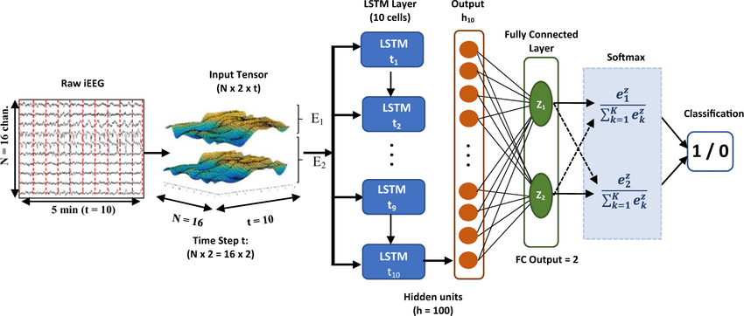
LSTM Layers
We create multiple LSTM neurons to form a layer
Source: https://www.researchgate.net/figure/LSTM-neural-network-architecture-Input-layer-consists-of-10-sequential-time-steps-10_fig3_336900652

Slide 18
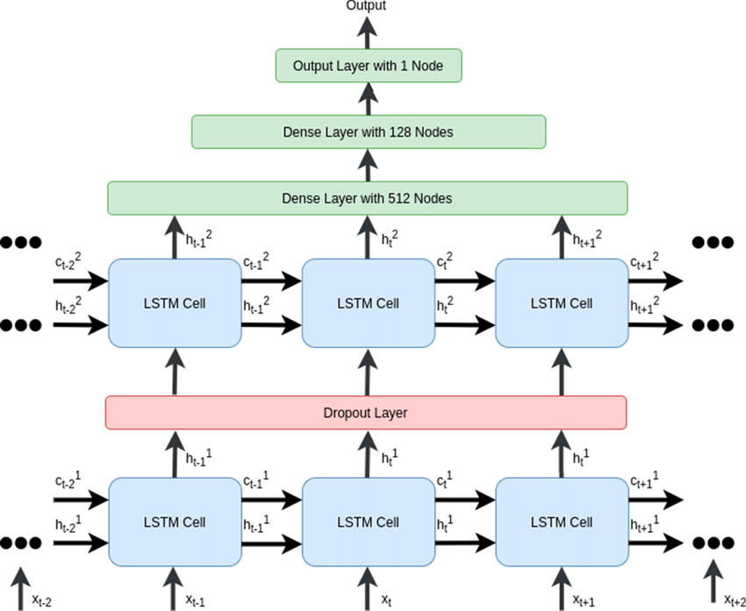
Stacking LSTM Layers
We create multiple LSTM neurons to form a layer
Source: https://www.researchgate.net/figure/Two-layered-stacked-LSTM-network_fig3_350105975

Slide 19
Python
Notes:
Guidelines
Use a title slide at the beginning of your presentation. There are 9 variations of title slides to choose from.
If you will have a series of slideshows, we recommend using the same style of title slide for each presentation.
Keep your title to no more than 2 lines.
Do not change the font style or font size of the title or subtitle.

Slide 20
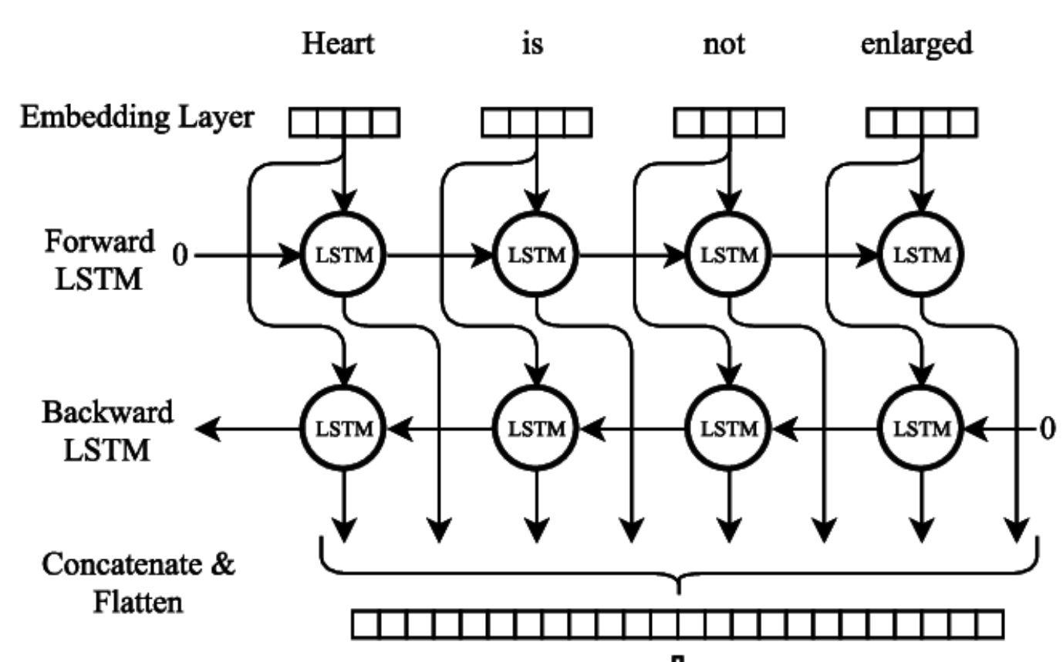
Bidirectional LSTM Layers
A Bidirectional LSTM (BiLSTM) runs two LSTM layers: forward and backward.
It captures information from both past and future contexts.
Enhances sequence understanding compared to a standard (unidirectional) LSTM.
Source: Modelling Radiological Language with Bidirectional Long Short-Term Memory Networks, Cornegruta et al

Slide 21
Python
Notes:
Guidelines
Use a title slide at the beginning of your presentation. There are 9 variations of title slides to choose from.
If you will have a series of slideshows, we recommend using the same style of title slide for each presentation.
Keep your title to no more than 2 lines.
Do not change the font style or font size of the title or subtitle.

Slide 22
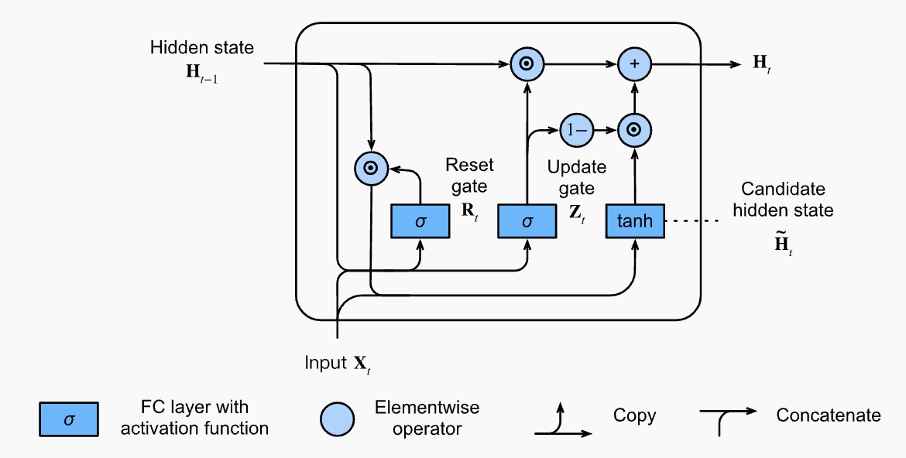
Gated Recurrent Unit (GRU)
Streamlined version of the LSTM
Achieves comparable performance

Slide 23
Python
Notes:
Guidelines
Use a title slide at the beginning of your presentation. There are 9 variations of title slides to choose from.
If you will have a series of slideshows, we recommend using the same style of title slide for each presentation.
Keep your title to no more than 2 lines.
Do not change the font style or font size of the title or subtitle.

